Slide 1

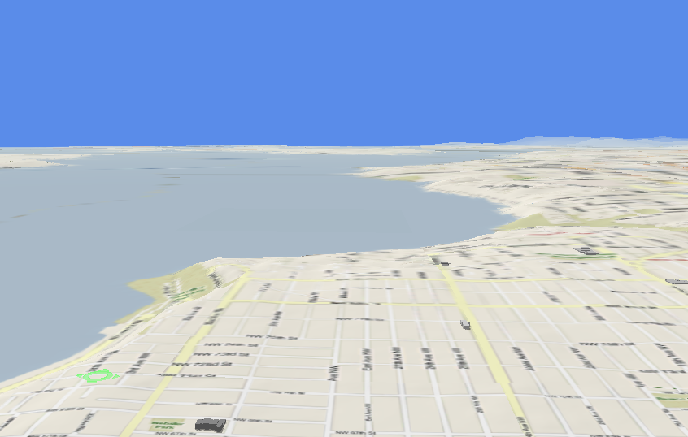





Trajectory Data Mining
Dr. Yu Zheng
Lead Researcher, Microsoft Research
Chair Professor at Shanghai Jiao Tong University
Editor-in-Chief of ACM Trans. Intelligent Systems and Technology
http://research.microsoft.com/en-us/people/yuzheng/
Notes:
A Location trajectory is a geospatial trail generated by a moving object. Typically, this trail is represented by of a set of time-ordered points.
The advance of location-acquisition technologies has boosted the increase of location trajectories, which record the trails of a variety of moving objects, such as people, vehicles, animals and nature phenomena.
These trajectories have not only enabled many applications significantly changing the way we live but also provided us with the scientific observations to understand the objects creating the trajectory.
As a result, the location trajectory has become the foundation a lot of research and attracted intensive attentions from a multitude of areas including computer sciences, biology, sociology, geography, and climatology, etc.

Slide 2
Paradigm of Trajectory Data Mining
Yu Zheng. Trajectory Data Mining: An Overview. ACM Transactions on Intelligent Systems and Technology. 2015, vol. 6, issue 3.

Slide 3
Anomaly Detection from Trajectories
Detect outlier trajectories
Taxi drivers’ malicious detour
Unexpected road change (caused by accident and construction)
Detect anomalous events based on trajectories
Traffic accidents
Disasters
…….

Slide 4
Detect Anomalies Based on Trajectories
Categorized by the form of locations
Link-based: Between regions or on a road network
Region-based: in a region/grid or a set of regions/grids
Categorized by methods
Distance-based outlier detection methods
Probabilistic distribution-based methods
Link-based
Region-based

Slide 5
Traffic Anomalies Between Regions
Map Segmentation. Segmentation of Urban Areas Using Road Networks. MSR-TR-2012-65. 2012.
Wei Liu, Yu Zheng, et al. Discovering Spatio-Temporal Causal Interactions in Traffic Data Streams. KDD 2011.

Slide 6
For each link
For each property
Using Euclidian distance
Using Mahalanobis distance
Find the minimum distort
Check spatial neighborhoods
Check temporal neighborhoods
Wei Liu, Yu Zheng, et al. Discovering Spatio-Temporal Causal Interactions in Traffic Data Streams. KDD 2011.

Slide 7
Traffic Anomalies Between Regions
Associate individual anomalies based on temporal adjacency
Wei Liu, Yu Zheng, et al. Discovering Spatio-Temporal Causal Interactions in Traffic Data Streams. KDD 2011.

Slide 8
Diagnosing the Road Traffic Anomalies
Sanjay Chawla, Yu Zheng, and Jiafeng Hu. Inferring the root cause in road traffic anomalies, ICDM 2012.

Slide 9
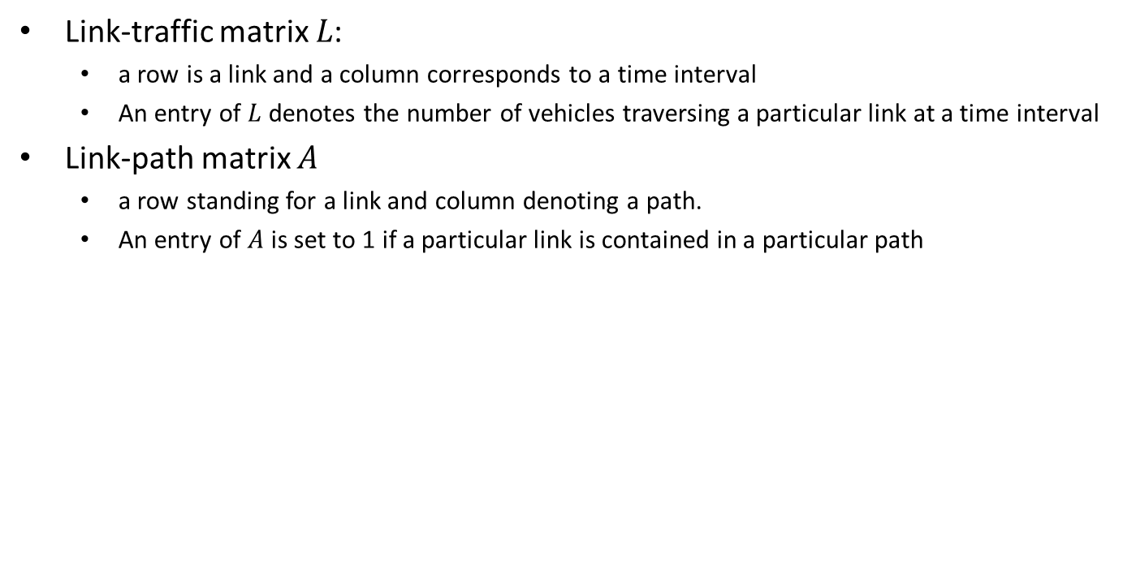
Diagnosing the Road Traffic Anomalies
Link-traffic matrix $L$:
a row is a link and a column corresponds to a time interval
An entry of $L$ denotes the number of vehicles traversing a particular link at a time interval
Link-path matrix $A$
a row standing for a link and column denoting a path.
An entry of $A$ is set to 1 if a particular link is contained in a particular path
Sanjay Chawla, Yu Zheng, and Jiafeng Hu. Inferring the root cause in road traffic anomalies, ICDM 2012.

Slide 10
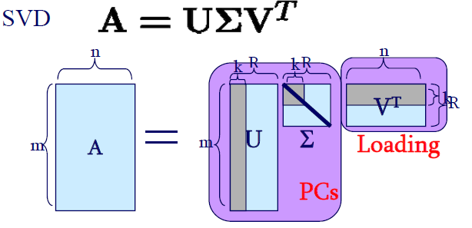
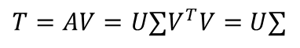
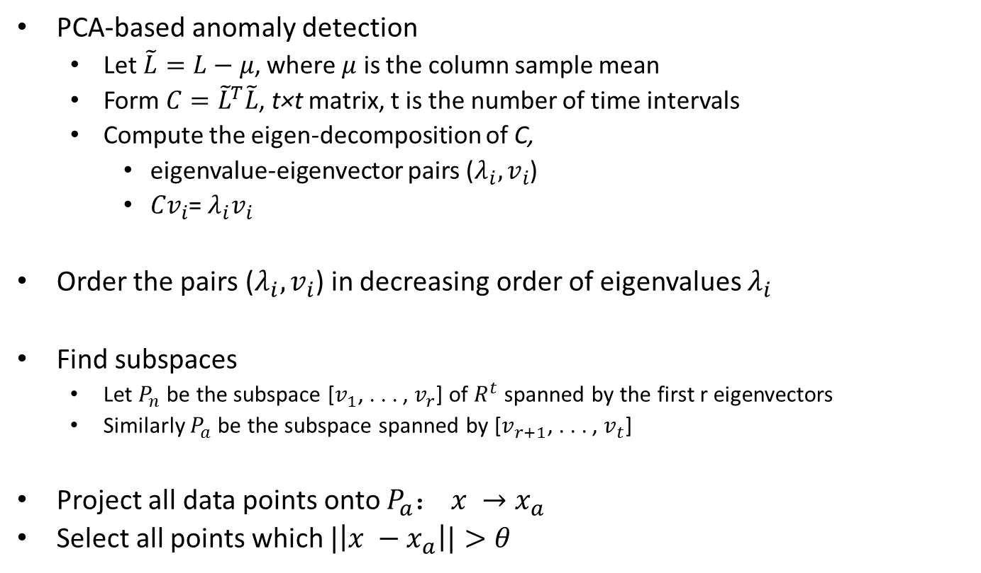
Diagnosing the Road Traffic Anomalies
PCA-based anomaly detection
Let $\tilde{L}=L−μ$, where $μ$ is the column sample mean
Form $C={\tilde{L}}^{T}\tilde{L}$, t×t matrix, t is the number of time intervals
Compute the eigen-decomposition of C,
eigenvalue-eigenvector pairs ($λ_{i},v_{i}$)
${Cv}_{i}$= $λ_{i}v_{i}$
Order the pairs ($λ_{i},v_{i}$) in decreasing order of eigenvalues $λ_{i}$
Find subspaces
Let $P_{n}$ be the subspace [$v_{1}$, . . . , $v_{r}$] of $R^{t}$ spanned by the first r eigenvectors
Similarly $P_{a}$ be the subspace spanned by [$v_{r+1}$, . . . , $v_{t}$]
Project all data points onto $P_{a}$： $x →x_{a}$
Select all points which $|\left|x −x_{a}\right||>θ$
$T=AV=U∑V^{T}V=$ $U∑$

Slide 11
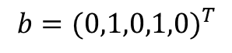
Diagnosing the Road Traffic Anomalies
$${b=(0,1,0,1,0)}^{T}$$
Using L1 norm and linear programing
L1 norm is more meaningful than L2
CVX tool in Matlab
Sanjay Chawla, Yu Zheng, and Jiafeng Hu. Inferring the root cause in road traffic anomalies, ICDM 2012.

Slide 12
Crowd Sensing of Traffic Anomalies based on Human Mobility and Social Media
Bei Pan, Yu Zheng, et al. Crowd Sensing of Traffic Anomalies based on Human Mobility and Social Media. ACM SIGSPATIAL GIS 2013.

Slide 13
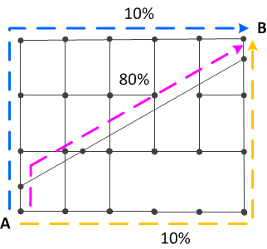
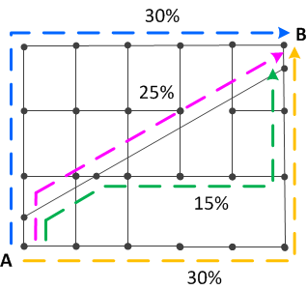
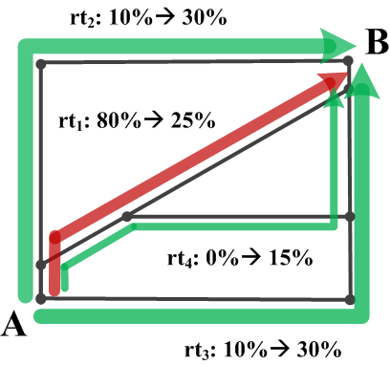
13
Detect Anomalies Based on Routing Patterns
During regular times
During
anomalous event
Increase of routing behavior
Anomalous graph
Decrease of routing behavior

Slide 14

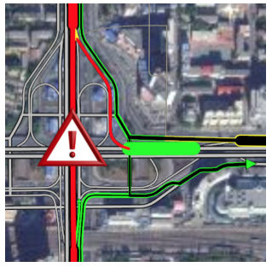
Understand Anomalies Using Social Media
Understand the traffic anomalies
Describe the anomaly using social media
Impact analysis on travel time delay
Detected anomalous graph

Slide 15
Describing Anomalies with Social Media
Bei Pan, Yu Zheng, et al. Crowd Sensing of Traffic Anomalies based on Human Mobility and Social Media. ACM SIGSPATIAL GIS 2013.

Slide 16
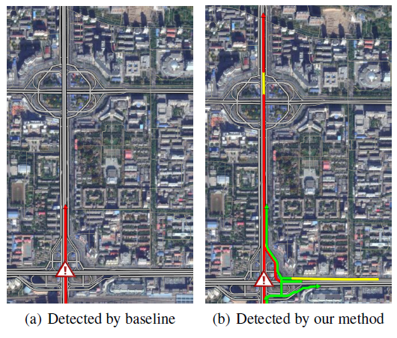
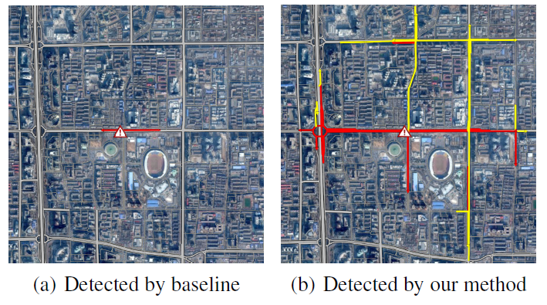

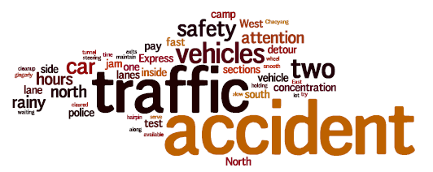
Bei Pan, Yu Zheng, et al. Crowd Sensing of Traffic Anomalies based on Human Mobility and Social Media. ACM SIGSPATIAL GIS 2013.

Slide 17
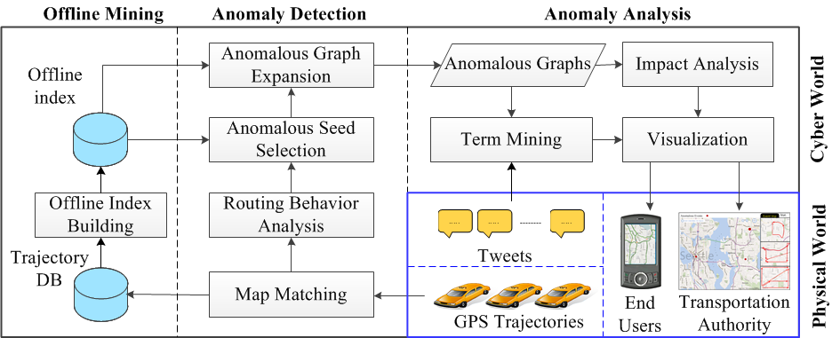
System Overview
Bei Pan, Yu Zheng, et al. Crowd Sensing of Traffic Anomalies based on Human Mobility and Social Media. ACM SIGSPATIAL GIS 2013.

Slide 18
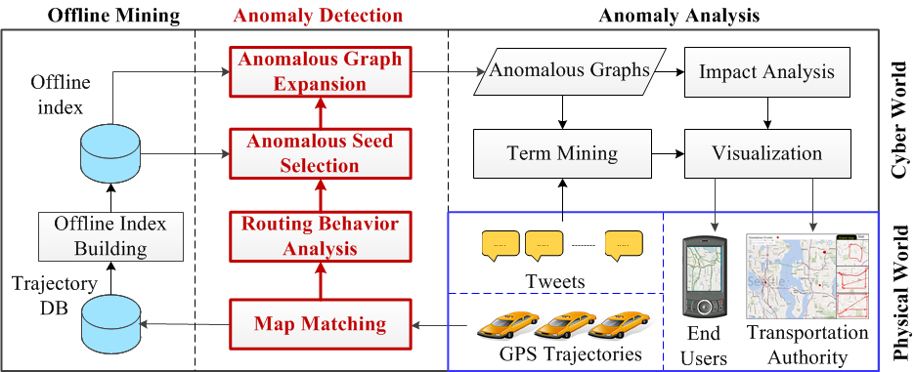
System Overview
Bei Pan, Yu Zheng, et al. Crowd Sensing of Traffic Anomalies based on Human Mobility and Social Media. ACM SIGSPATIAL GIS 2013.

Slide 19
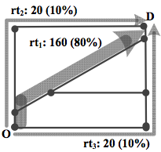
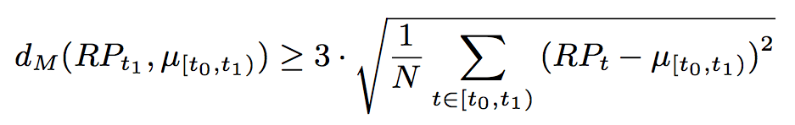
Routing Behavior Analysis
Routing Behavior:
RP_{OD} =< f₁ , p₁ , f₂ , p₂ , ... , f_{n} , p_{n} >
f : traffic flow / p: percentage
e.g., RP_{OD} =<160, 0.8, 20, 0.1, 20, 0.1>
Anomaly Detection Problem Definition:
Given a complete road network, trajectory set in [t₀, t₁], find graphs
For each O, at least one D, that the RP_{OD} at time t₁ is anomalous compared with regular RP_{OD} at time [t₀, t₁):
Bei Pan, Yu Zheng, et al. Crowd Sensing of Traffic Anomalies based on Human Mobility and Social Media. ACM SIGSPATIAL GIS 2013.
Notes:
Why the coefficient is 3? Because we assume the data distribution is Gussian Distribution, 3 is the standard coefficient to detect outliers

Slide 20
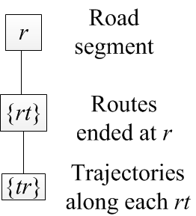
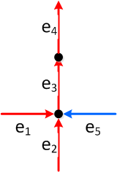
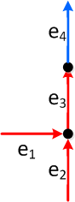
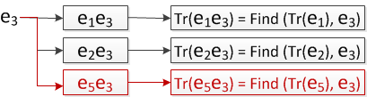
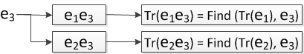
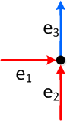
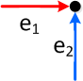
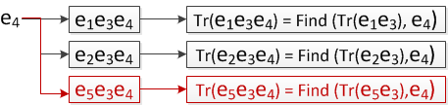
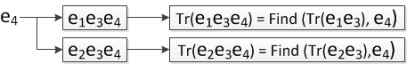
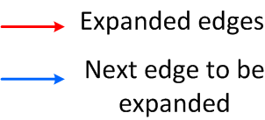
Anomaly Detection
Our solution:
Priority Breadth Graph Expansion
Verifications of anomalous RP on all OD pairs
Index:
Index Update: one edge at a time

Slide 21
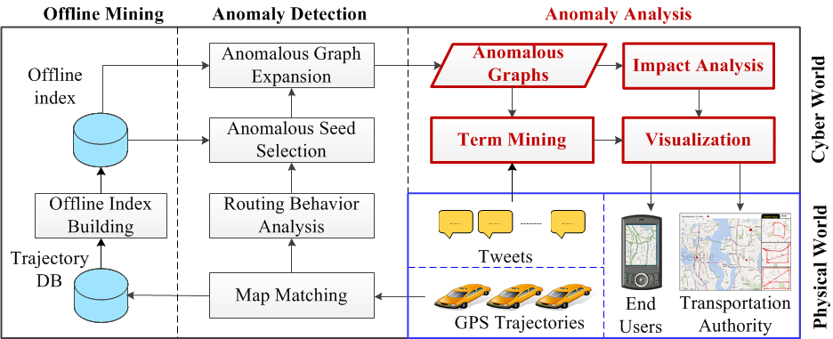
System Overview
Bei Pan, Yu Zheng, et al. Crowd Sensing of Traffic Anomalies based on Human Mobility and Social Media. ACM SIGSPATIAL GIS 2013.

Slide 22
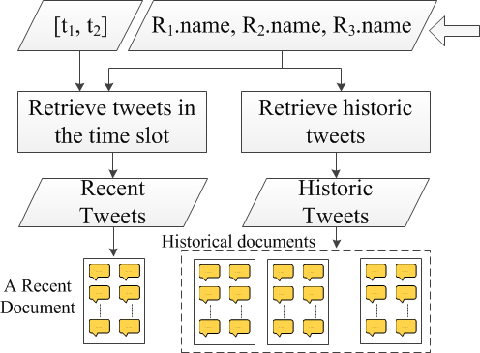
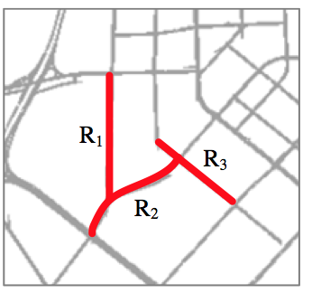
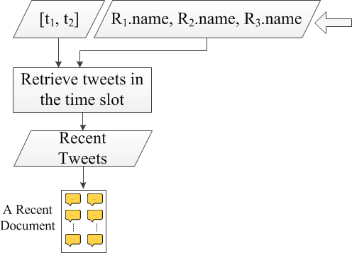

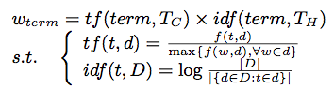
Term Mining
(T_{H})
(T_{C})
Bei Pan, Yu Zheng, et al. Crowd Sensing of Traffic Anomalies based on Human Mobility and Social Media. ACM SIGSPATIAL GIS 2013.
Notes:
In the beginning of the slides, need to specify the reduce of searching space. (we are not searching through entire pool of social media)
Trying to identify the set of key words that only in recent document but not in historical documents () ,

Slide 23
Detecting Anomalies Based on Log Likelihood Ratio Test
L. X. Pang, Sanjay Chawla, Wei Liu, Yu Zheng. On Detection of Emerging Anomalous Traffic Patterns Using GPS Data. Data & Knowledge Engineering, 2013
Yu Zheng, Huichu Zhang, Yong Yu. Detecting Collective Anomalies from Multiple Spatio-Temporal Datasets across Different Domains. ACM SIGSPATIAL 2015

Slide 24
Partition a City into Regions
Project trajectories of moving objects (e.g. vehicles) into regions
Count the number of moving objects in each region
Apply log likelihood ratio test (LRT) to regions
L. X. Pang, Sanjay Chawla, Wei Liu, Yu Zheng. On Detection of Emerging Anomalous Traffic Patterns Using GPS Data. Data & Knowledge Engineering, 2013
Yu Zheng, Huichu Zhang, Yong Yu. Detecting Collective Anomalies from Multiple Spatio-Temporal Datasets across Different Domains. ACM SIGSPATIAL 2015

Slide 25
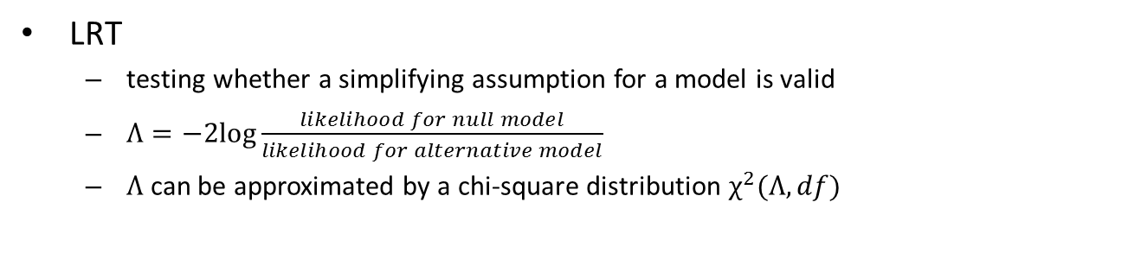
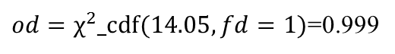
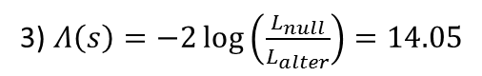
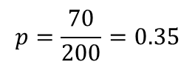
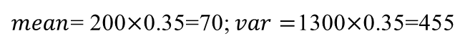
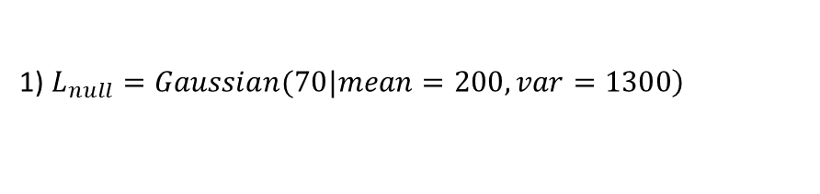
Apply LRT to a Spatio-Temporal Setting
LRT
testing whether a simplifying assumption for a model is valid
$Λ=−2log\frac{likelihood for null model}{likelihood for alternative model}$
$Λ$ can be approximated by a chi-square distribution $χ^{2}(Λ, df)$
An example for a single region and a single dataset
1) $\left.L_{null}=Gaussian(70|mean=200,var=1300\right)$
2) The maximum likelihood for the alternative model (mean to 70)
$$p=\frac{70}{200}=0.35$$
$mean$= 200$×$0.35=70; $var=$1300$×$0.35=455
$L_{alter}=Gaussian(70|mean=70, var=455)$;
70
200
3) $Λ\left(s\right)=−2\log\left(\frac{L_{null}}{L_{alter}}\right)=14.05$
$od=χ^{2}_cdf(14.05, fd=1)$=0.999
Yu Zheng, Huichu Zhang, Yong Yu. Detecting Collective Anomalies from Multiple Spatio-Temporal Datasets across Different Domains. ACM SIGSPATIAL 2015
Notes:
a likelihood ratio test is used to compare the fit of two models, one of which (the null model) is a special case of the other (the alternative model).
Each of the two competing models is separately fitted to the data with the log-likelihood recorded.
The test statistic is negative twice the difference in these log-likelihoods.

Slide 26
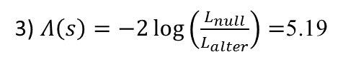
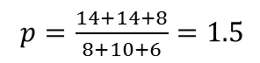
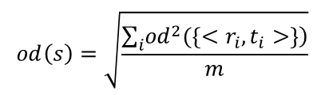
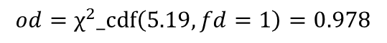
Apply LRT to a Spatio-Temporal Setting
Apply LRT to multiple regions (or time slots)
A dataset varies in different regions (or time slots) consist­ently
1) $L_{null}=Poi\left(14 | λ_{1}=8\right)×Poi\left(14 | λ_{2}=10\right)×Pois(8|λ_{3}=6)$;
2) Calculate $Θ^{′}=\{{λ^{′}}_{1},{λ^{′}}_{2}, {λ′}_{3}\}$: To maximize the likelihood of the alternative model ($fd$=1)
$p=\frac{14+14+8}{8+10+6}=1.5$
${λ′}_{1}=$8$×$1.5=12, ${λ′}_{2}$=10$×$1.5=15, ${λ′}_{3}$=6$×$1.5=9;
$L_{alter}=Poi\left(14 | {λ′}_{1}\right)×Poi\left(14 | {λ′}_{2}\right)×Pois(8|{λ′}_{3})$;
3) $Λ\left(s\right)=−2\log\left(\frac{L_{null}}{L_{alter}}\right)=$5.19
$$od=χ^{2}_cdf\left(5.19,fd=1\right)=0.978$$
A dataset changes differently in different regi­ons (or slots).
$$od\left(s\right)=\sqrt{\frac{\sum_{i}{\left.{od}^{2}(\left\{{<r}_{i},t_{i}>\right\}\right)}}{m}}$$
Yu Zheng, Huichu Zhang, Yong Yu. Detecting Collective Anomalies from Multiple Spatio-Temporal Datasets across Different Domains. ACM SIGSPATIAL 2015

Slide 27
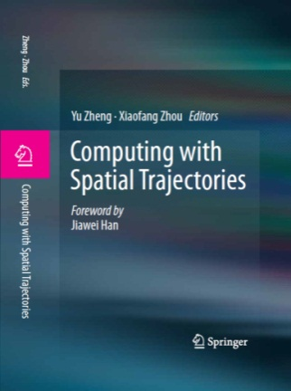

Thanks!
Yu Zheng
yuzheng@microsoft.com
Homepage
Yu Zheng. Trajectory Data Mining: An Overview.
ACM Transactions on Intelligent Systems and Technology. 2015, vol. 6, issue 3.

